Slide 1

Deck Template : 2023
Follow instructions on Black slides, and edit the White slides.

Slide 2

PRE SEED PITCH DECK, UK COMPANY, FOUNDED 2022

Slide 3
SECTION ONE: Company Purpose
As the first section of your pitch deck, the company purpose slide should offer a clear, memorable one-sentence explanation of your company’s goal.
Avoid complicated, grandiose vision statements. Clarity is key here: Boiling your purpose down to a single sentence will help hook investors at the beginning so they continue to read through your deck.
Consider different possibilities and run them past other people to make sure your purpose statement is not only compelling but makes sense. Remember: Clearly defining your vision statement can be more art than science.
Target section length: 1-page
Industry averages:
  Average length: 1.3 pages
  Time VCs spend here: 33 seconds
TOP TIP:
At the top of your document, design is arguably more important than the words. Focus on look and feel, ensure it captures your brand vibe and tone.

Slide 4
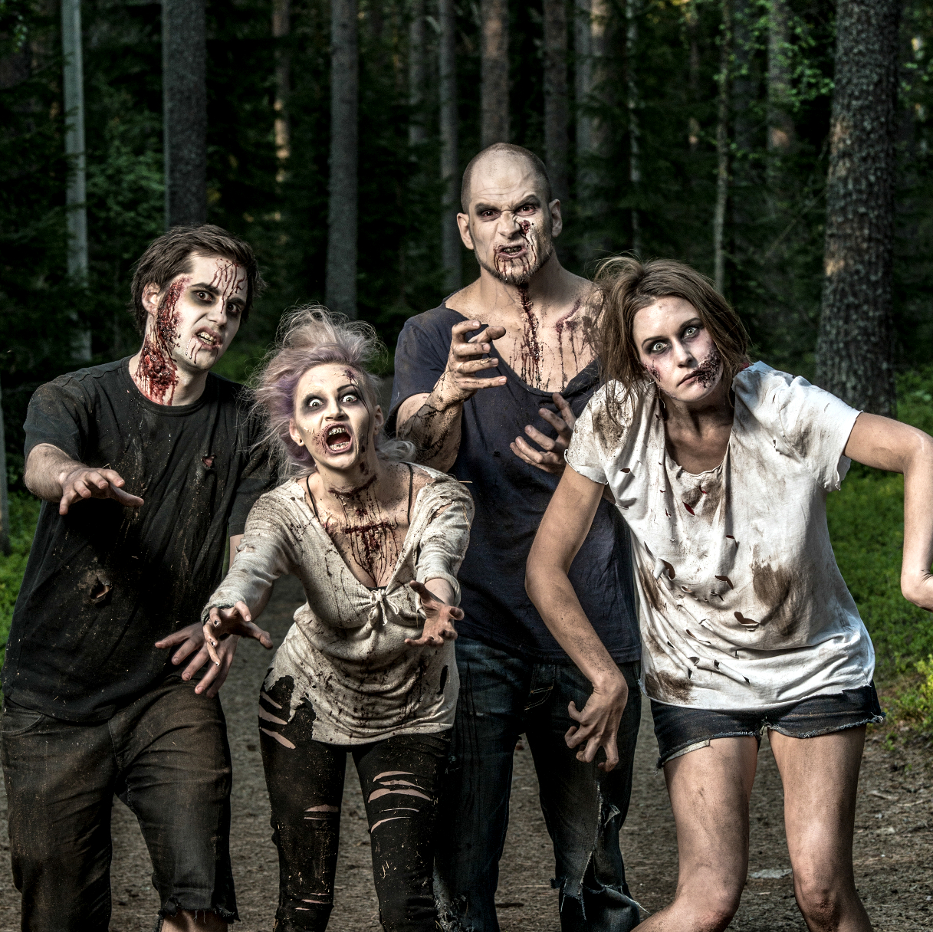

Our mission
To be the largest supplier of zombie related products and services worldwide.
Our mission at Apocalypse Preparedness Institute (API) is to empower individuals and communities to prepare for any disaster, including zombie outbreaks. Through our expert training programs and cutting-edge equipment, we aim to equip our customers with the knowledge and tools needed to survive in the face of adversity.

Slide 5
SECTION TWO: Problem
Similar to your purpose statement slide, the second section should broadly define the specific problem your company is solving.
Avoid long-winded problem statements. Explain the problem at its broadest level and use simple, easy-to-understand words that make it easy for anyone to follow along.
Consider whether a VC in a different space will understand what you’re trying to solve and why? Can a non-technical person? Your grandparents? Your problem (and solution!) needs to be compelling and relatable to lots of different stakeholders.
Target section length: 1-2 pages
Industry averages:
  Average length: 2.15 pages
  Time VCs spend here: 39 seconds
TOP TIP:
Check the news for something that is relevant to your startup, we want the problem to be linked to the real world. The narratives change each week so ensure you keep up.

Slide 6
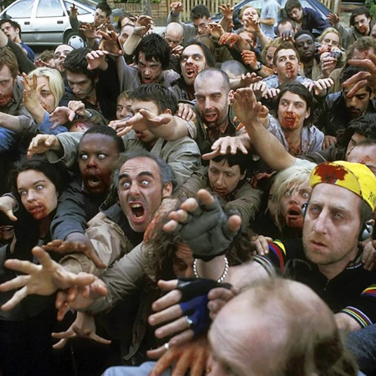
The problem affecting 790m people globally.
Almost 10% of the global population dread zombies.
One of the greatest potential threats to humanity is a zombie outbreak, and the impact of such an event could be catastrophic. Unfortunately, most people are unprepared for any type of disaster, let alone a zombie apocalypse. They lack the knowledge, skills, and equipment needed to survive in a world gone mad.

Slide 7
SECTION THREE: Solution
Immediately following your problem statement, the solution section highlights how your company is solving the defined problem in a unique way.
Avoid technical product details. Three slides in is too early to get in the weeds of your product. Instead, focus on what makes your strategic approach creative and different than anyone else’s.
Consider the alignment between your problem and solution slides. Try to keep both sections at the same level of breadth and depth while outlining a clear, understandable solution.
Target section length: 1-2 pages
Industry averages:
  Average length: 1.5 pages
  Time VCs spend here: 27 seconds
TOP TIP:
Ensure your solution is clear and compelling. The biggest mistake we see here is the lack of clarity. Make sure you are actually obviously clear about what your solution is!

Slide 8
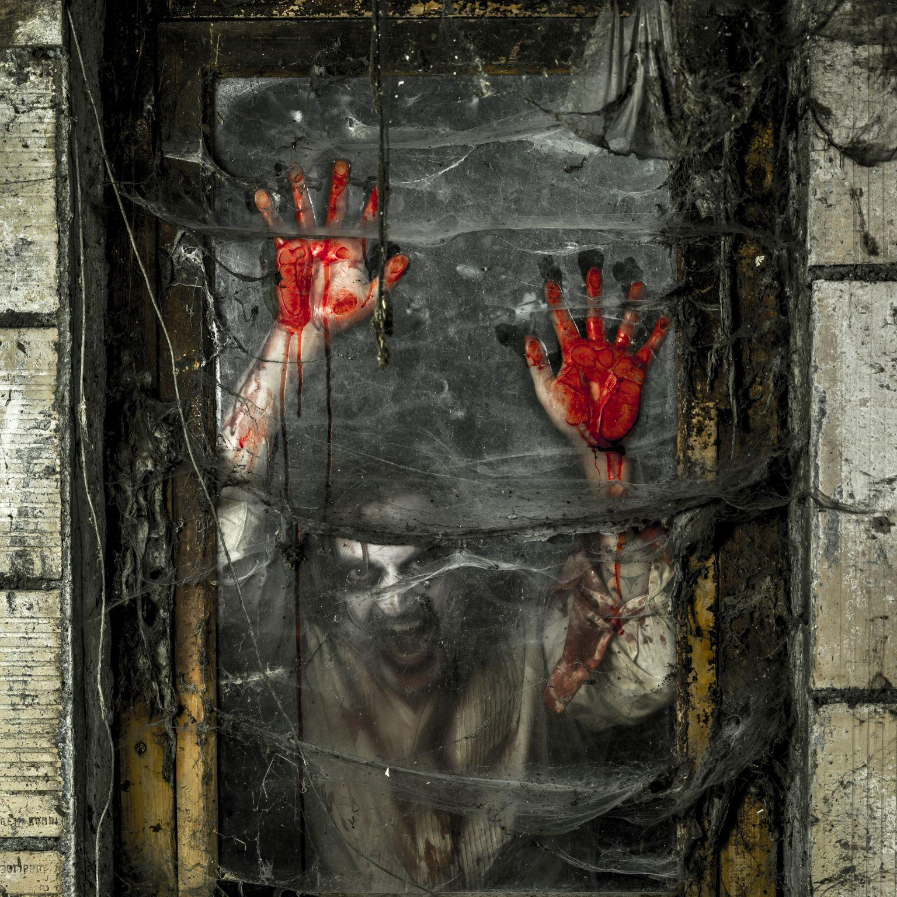
Our solution can save humanity
API prepares for the worst with engaging expert training, technology and top-of-the-line equipment.
At Apocalypse Preparedness Institute (API), we provide expert training and access to top-of-the-line equipment, so that individuals and communities can be fully prepared for any disaster, including zombie outbreaks.

Slide 9
SECTION FOUR: Why Now?
The “Why now?” slide talks about current market conditions that make your company possible or present an opportunity for your solution. Common examples here might include things such as Covid, climate change, or social justice.
Avoid adding this section to your pre-seed deck if there isn’t any particular timeliness to your solution, product, or company.
Consider the urgency of your problem and its solution. While this section isn’t used by every founder at the pre-seed stage, it can prove especially useful if you can point to the gravity of an urgent issue.
Target section length: 1-page
Industry averages:
  Average length: 1.5 pages
  Time VCs spend here: 38 seconds
TOP TIP:
Buzzwords galore. Get them all in. This slide has to be the “eureka” moment for the reader. Make them feel like they can make a difference for this horrible problem.

Slide 10
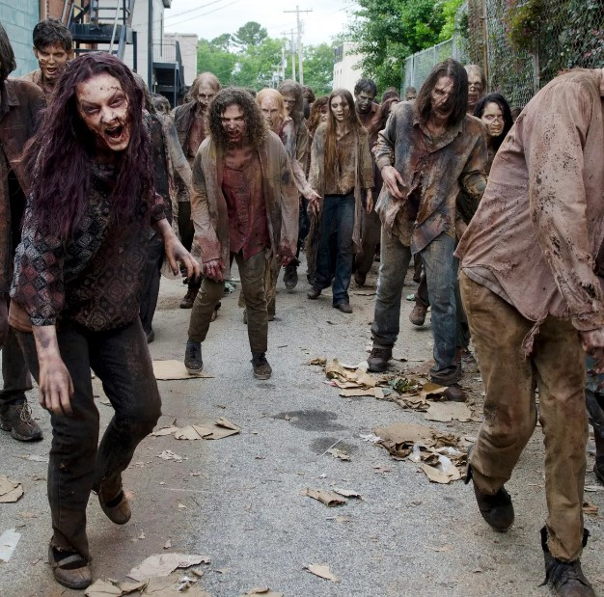
We can’t leave it too late to act.
Increased interest in disaster preparedness: With recent events such as the COVID-19 pandemic and natural disasters like hurricanes and wildfires, there has been a growing interest in disaster preparedness. People are realizing the importance of being ready for unexpected events, and a zombie survival training business can capitalize on this trend.
Popularity of zombie culture: The popularity of zombie-themed movies, TV shows, and video games has never been higher. This has created a large and enthusiastic audience for zombie-related products and services, including zombie survival training.

Slide 11
SECTION FIVE: Product
The product section comes earlier in pre-seed pitch decks than later-stage decks and highlights product features that demonstrate why your company can solve the problem statement.
This section is one of the most highly scrutinized sections in a pre-seed deck and investors need to understand what your product experience will look like.
Consider going as deep as you can into your product readiness. Include different examples such as wireframes, screenshots, embedded videos, figma mockups, or product feature gifs. You can also add contextual headlines or brief feature explanations to make your product easy to understand.
Target section length: 3-4 pages
Industry averages:
  Average length: 3.3 pages
  Time VCs spend here: 77 seconds
TOP TIP:
I always imagine I run a soft drinks company in this section. If you sell canned drinks, how can you possibly expect someone to invest in your business if they wouldn't pick it up next to a can of Coke in a busy supermarket fridge. VISUAL SLIDE.

Slide 12
Our unique complete offering
Our product suite serves the core zombie survival community across the globe, with touch points both online and offline, surviving both retail customers and enterprise partners.
01
02
03
Training Experiences
E-commerce
Subscription App
Our training experiences combine fitness activity such as “cross fit” with fun activities like “Tough Mudder” and escape rooms. Get ready for the zombie apocalypse in fun real world scenarios. D2c, can be sold b2b for corporate wellness.
We are the number one online marketplace for zombie safety equipment such as video cameras, fencing and weaponry. We charge a margin of 30% on all goods sold and also offer a p2p marketplace making us the only circular zombie supply platform globally.
Our mobile app charges £9.99 a month and is available on the ios and google play store. We use the most innovative technology to match you with other survivors in an apocalypse and also we use location data to track any local or regional outbreaks.

Slide 13
SECTION SIX: Market Size
The market size section is shorter than your product section. It clearly defines your target customer profile with a comprehensive analysis of current market conditions and future growth potential (TAM, SAM, SOM).
Avoid understating the true size of your market (and your idea!). Here, you need to show investors that your problem and its addressable market are big enough to warrant an entire company, not just an idea or set of features.
Consider how your market size section connects back to your purpose, problem, and solution sections. The four areas should be interwoven to hook your investors and pull a cohesive narrative throughout the entire deck.
Target section length: 1-page
Industry averages:
  Average length: 1.7 pages
  Time VCs spend here: 39 seconds
TOP TIP:
This is all about how much money can you make. If you have a big market you need to show it. Be careful not to alienate reader with stupid numbers though.

Slide 14

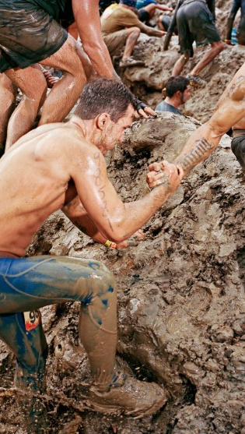
Our market is huge
Over 4 million people worldwide have participated in Tough Mudder events. More than 10k per event!
The top zombie movies have grossed a combined $1 TRILLION with popular franchises across both movies and games continuing to thrive. According to Google Trends, searches for the term "zombie" have remained consistently high and is searched more than the term famine. Showing what people really are concerned about.
According to a survey conducted by Statista, over 60% of Americans have watched or read something related to zombies in the past year.
The zombie-themed 5k obstacle race "Run for Your Lives" attracted over 400,000 participants in its first year.

Slide 15
SECTION SEVEN: Team
The team section introduces who makes up your founding team and what their backgrounds are. In the pre-seed stage, VCs are especially invested in individuals as much as they are in the big ideas.
Avoid adding more context than needed. This section will naturally border on being one of the wordiest in your deck so only include extra information if it warrants it.
Consider how to best showcase your founding members’ skill sets using pictures, bios, and their relevant work experiences. Always connect your team bios back to your company, its vision, and the problem you’re solving.
Target section length: 1-2 pages
Industry averages:
  Average length: 1.5 pages
  Time VCs spend here: 46 seconds
TOP TIP:
No one cares about your part time once a quarter advisor, they want to know who the money is going too. Focus on the founders only.

Slide 16

Paranoid about Zombies with a passion for business. Ex vc funded founder for automotive business, supported 150+ crowdfunding campaigns and expert with early stage start up finance and funding.
Meet Jamie
CEO

Slide 17

Graduated from Cambridge with a degree in Natural Science, he also holds the financial modelling certificate from the Corporate Finance Institute and is studying towards a Management accountant certificate (CIMA).
Meet Ivan
CFO

Slide 18
SECTION EIGHT: Business Model
The business model section should articulate a clear monetization plan and go-to-market strategy.
Avoid anchoring your entire deck on little more than a cool idea—our latest research shows that this section receives the longest look from investors. Come up with an actual plan for how you can monetize your idea and how it will evolve over time.
Consider your business model long before building your pre-seed deck. Then, map out your monetization plans and product-market fit as you build your product. Give investors a clear sense of how your company will make money and explain your business model in easy-to-understand terms.
Target section length: 2-3 pages
Industry averages:
  Average length: 2.8 pages
  Time VCs spend here: 83 seconds
TOP TIP:
Investors really want to learn about how you plan to win your first revenues. Try to focus on 0 - 1, the big stuff is exciting but showing you have this early stage mapped out is very appealing.

Slide 19


We generate revenue
We have cultivated a global army of zombie enthusiasts using viral culture. We can launch events in any city in the globe due to our fanbase.
25%
Ecommerce
We will target event goers with our zombie relevant ecommerce store
50%
Ticket Sales
We aim to sell 100,000 tickets to our training experience events in the first twelve months.
25%
App Subscriptions
We will offer fitness videos and trackers through our app.

Slide 20
SECTION NINE: Traction
This section should detail notable traction based on the stage of your product. Traction can include current customers, quotes, and testimonials.
Avoid skipping this section because you don’t think you have enough to show. Investors want to see any early indicators that you’re building the right product. They’ll take into account the stage you’re in but you need to show them your idea has legs.
Consider different ways to show your market traction. At the pre-seed stage, this can include letters of intent, testimonials, customer pipeline, and beta feedback.
Targeted section length: 1-4 pages
Industry averages:
  Average length: 2.3 pages
  Time VCs spend here: 37 seconds
TOP TIP:
Show how far you have come, how efficient you have been, how resourceful you are with capital. This section is designed to allow you to boast about the nerdy things that make you great.

Slide 21
Our traction is infectious
2020
Starting
2021
Planning
Our revenue grows year on year due to infecting our users with incurable illness.
We launched in 2020 having been bitten by a zombie in a park in England.
We realised it felt amazing and started planning how we could infect those around us.
User Acquisition: As of Q4 2020, we have had over 1,000 customers sign up for our training programs, with an average of 100 new sign-ups per month. We have also seen a 25% month-over-month growth in user acquisition since launching.

Slide 22
Our current revenue run rate is $500,000 per year, with a gross margin of 60%. We have seen consistent revenue growth since launching the business, with Q4 2020 revenue of $150,000, up from $50,000 in Q1 2020.Customer
Engagement: Our customers spend an average of 3 hours engaging with our training programs, and we have received positive feedback on the quality and effectiveness of our training.
Retention: We have seen a 100% retention rate for repeat customers, with many customers returning for additional training or equipment purchases.
Partnerships: We have established partnerships with several local businesses, including outdoor recreation stores and survivalist communities, to promote our services. These partnerships have resulted in a
2022
Growing
2023
Staying
We started launching events and saw great traction with 100% infection rates.
We have partnerships in place to grow beyond this years success.

Slide 23
SECTION TEN: Financials
Another optional section for pre-seed decks, the financials section outlines your company’s strategic spending history or burn rate.
Avoid this section if you can address your spending history or projections in the fundraising ask section.
Consider adding this section for your seed deck if you can show how your strategic spending fuels good returns over time. While this section is also optional at the seed stage, investors will likely give positive scrutiny to your financial history if there’s one to show.
Targeted section length: 1-2 pages
Industry averages:
  Average length: 1.4 pages
  Time VCs spend here: 40 seconds
TOP TIP:
This is your chance to show how your business scales. Show the revenue lines and how much it costs you to make that cash.

Slide 24

Financial forecast
FORECAST | 2022-23 | 2023-24 | 2024-25 | 2025-26 | 2026-27
Ticket Sales | 784,499.60 | 1,136,384.99 | 1,250,023.49 | 1,375,025.84 | 1,512,528.43
App Subscriptions | 467,331.87 | 640,991.89 | 653,811.73 | 666,887.96 | 680,225.72
Ecommerce | 283,583.76 | 379,067.24 | 386,648.58 | 394,381.55 | 402,269.19
Total Income | 1,588,090.23 | 2,330,149.12 | 2,515,119.40 | 2,665,423.67 | 2,828,734.21
Total Cost of Sales | 285,856.24 | 419,426.84 | 452,721.49 | 479,776.26 | 509,172.16
Gross Profit | 1,302,233.99 | 1,910,722.28 | 2,062,397.91 | 2,185,647.41 | 2,319,562.05
We see huge potential for profitable growth from year 1.
We have seen steady growth in user acquisition, revenue, and customer engagement, as well as strong retention rates for repeat customers. Our partnerships with local businesses have also contributed to our success, and we believe that we are well-positioned for future growth in the market

Slide 25
SECTION ELEVEN: Competition
In this section, you want to explain the uniqueness of your product relative to similarly-sized competitors.
Avoid aiming for the big dogs (i.e. the Ubers and Facebooks) in your space. Instead, stand out by showing VCs that you know who your true competitors are.
Consider which companies and products closely compete with yours, paying special attention to companies at similar stages or those who’ve recently raised money. Then, show VCs how your product solves the problem in ways theirs can’t.
Targeted section length: 1-page
Industry averages:
  Average length: 1.3 pages
  Time VCs spend here: 55 seconds
TOP TIP:
Show the funding of competitors. Use research to give a fair cross section of your target market and who else is playing. New challengers and incumbents.

Slide 26
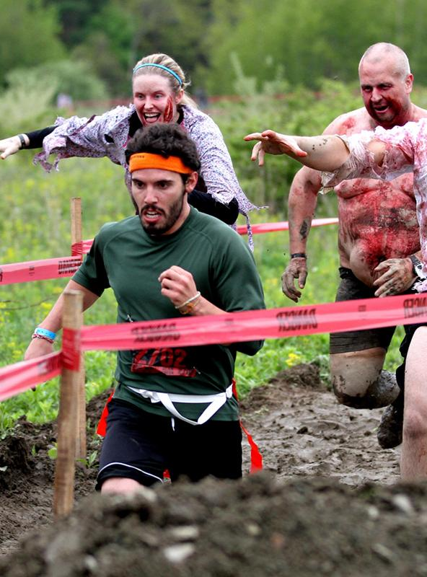
Competition
While these competitors offer similar services, we believe that our unique combination of immersive experiences, expert training, and cutting-edge equipment sets us apart from the competition. Our focus on creating a comprehensive, one-stop-shop for zombie survival training and disaster preparedness gives us a competitive advantage in the market.
Zombie Defense League: A startup that raised $2 million in seed funding in 2019. They offer a range of training programs, equipment, and merchandise related to zombie survival.
Undead Survival Training: A well-established player in the market, with over 10 years of experience in disaster preparedness training. They have received $5 million in funding to date and offer a range of services related to zombie and other disaster scenarios.
Z-Survival Training: A newer player in the market, with $1 million in seed funding raised in 2020. They focus specifically on zombie survival and offer training programs and equipment for individuals and businesses.

Slide 27
SECTION TWELVE: Fundraising Ask
In early-stage rounds, the fundraising ask is the final section in your deck. It outlines how much you plan to raise as well as your broad plans for deploying capital.
Avoid complexity. Tell investors exactly how much you’re asking for and be ready to defend how you plan to spend it.
Consider which categories you plan to spend money on such as hiring and research and development. Think of your fundraising ask section as the next chapter in your company that potential investors will help you write.
Target section length: 1-page
Industry averages:
  Average length: 1.2 pages
  Time VCs spend here: 40 seconds
TOP TIP:
Make it clear what you are asking for. If this isn't obvious it's a pretty automatic “no”.

Slide 28
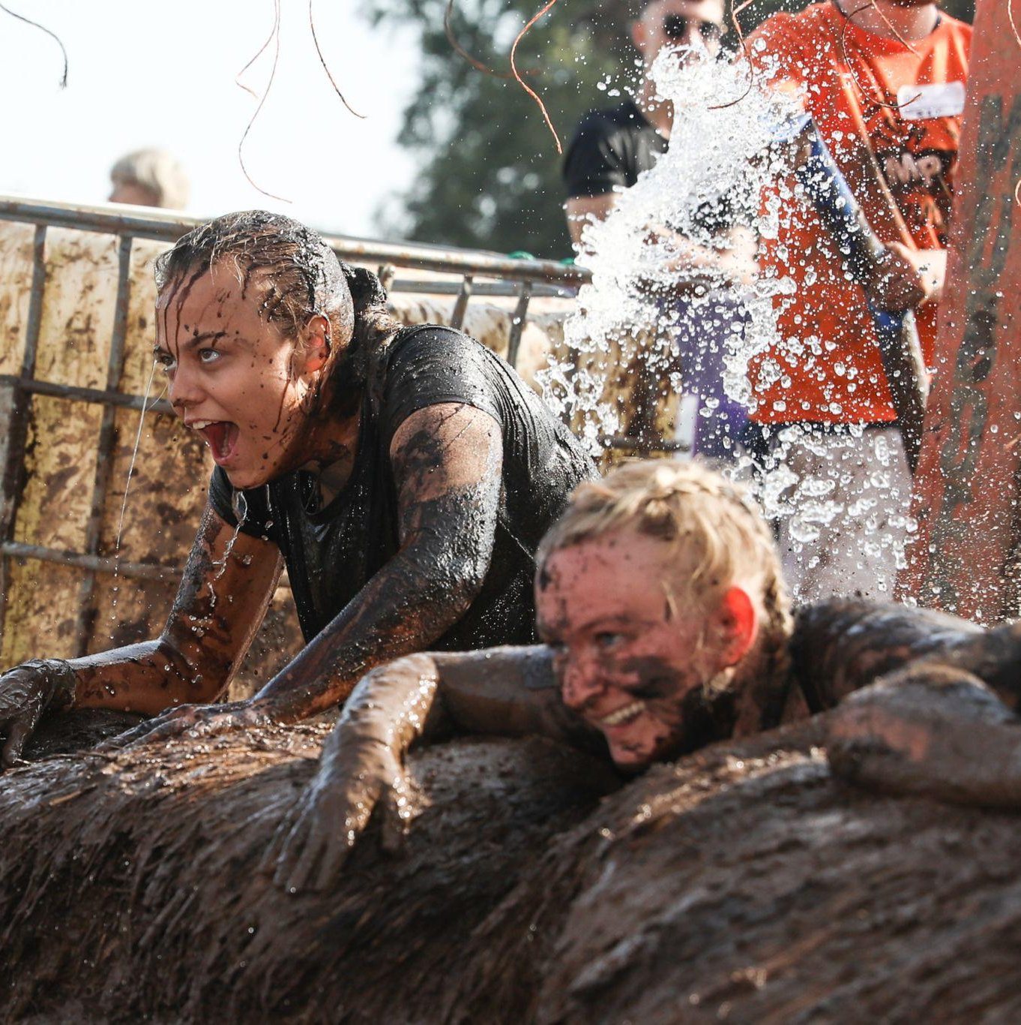
Our Ask
We are seeking £350,000 in funding to support the growth of our zombie survival training business. The funds will be used for the following purposes:
Expand training facilities (£150,000)
Develop new programs (£75,000)
Marketing and advertising (£50,000)
Create an ecommerce platform (£50,000)
Develop a mobile app (£25,000)
These investments will allow us to expand our services, reach new customers, and generate additional revenue. We aim to become the top provider of zombie survival training and disaster preparedness services with the help of our investors.

